Slide 1

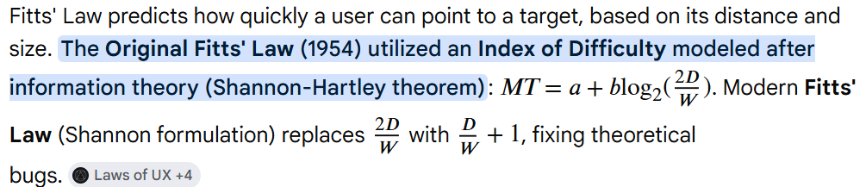
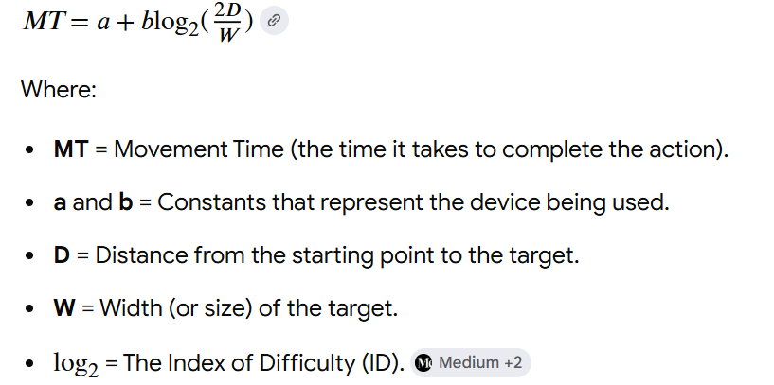
Fitts's Law
A predictive model of human movement stating that the time required to rapidly point to a target depends on its distance and size.
06 / 07 Sep 2026

Slide 2
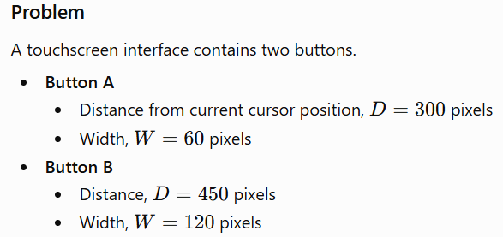
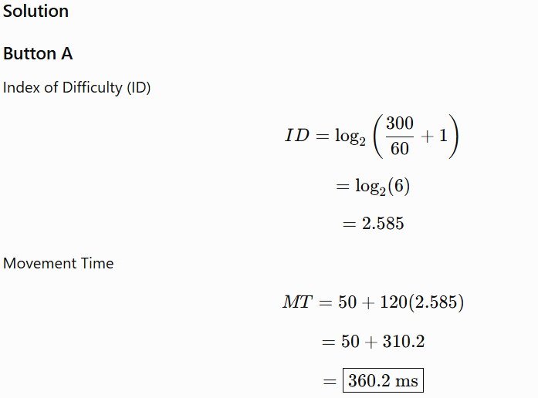
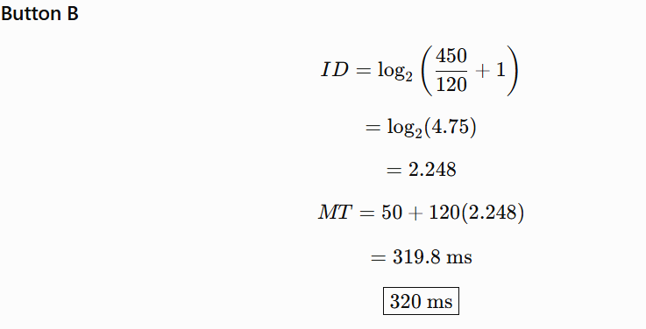
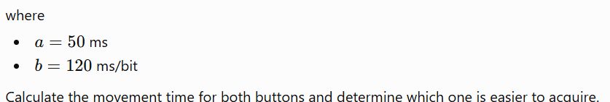
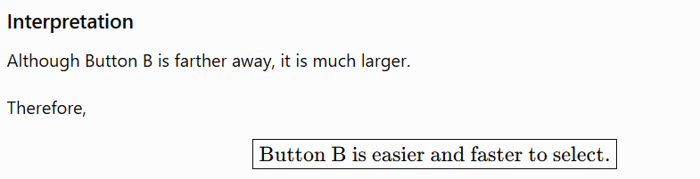
Fitts's Law
06 / 07 Sep 2026

Slide 3
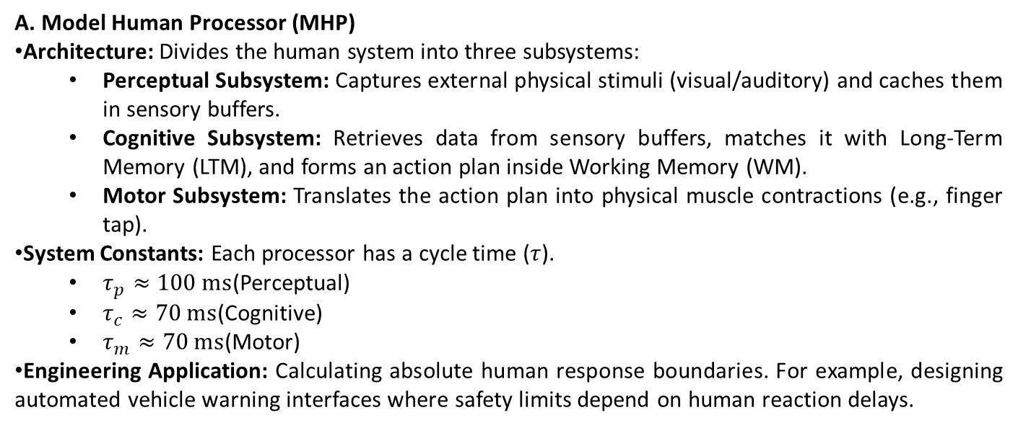
Cognitive & Human Performance Frameworks
A. Model Human Processor (MHP)
Architecture: Divides the human system into three subsystems:
  Perceptual Subsystem: Captures external physical stimuli (visual/auditory) and caches them in sensory buffers.
  Cognitive Subsystem: Retrieves data from sensory buffers, matches it with Long-Term Memory (LTM), and forms an action plan inside Working Memory (WM).
  Motor Subsystem: Translates the action plan into physical muscle contractions (e.g., finger tap).
System Constants: Each processor has a cycle time ($τ$).
  $τ_{p}≈100\text{ ms}$(Perceptual)
  $τ_{c}≈70\text{ ms}$(Cognitive)
  $τ_{m}≈70\text{ ms}$(Motor)
Engineering Application: Calculating absolute human response boundaries. For example, designing automated vehicle warning interfaces where safety limits depend on human reaction delays.
06 / 07 Sep 2026

Slide 4
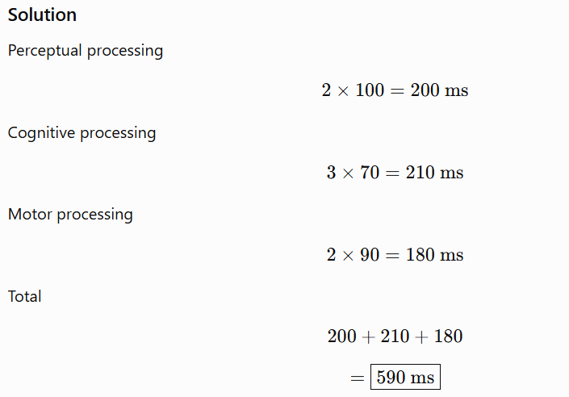
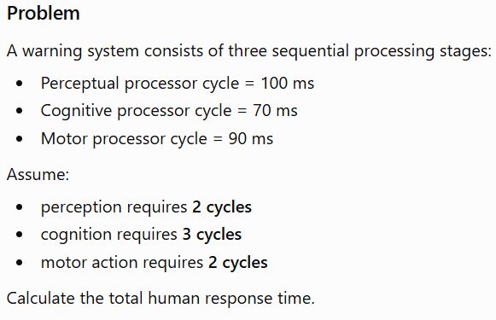
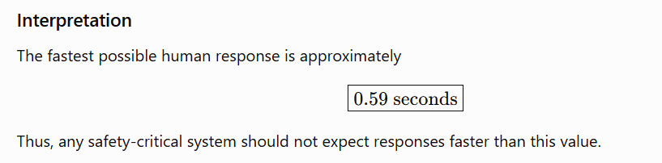
Cognitive & Human Performance Frameworks
06 / 07 Sep 2026

Slide 5
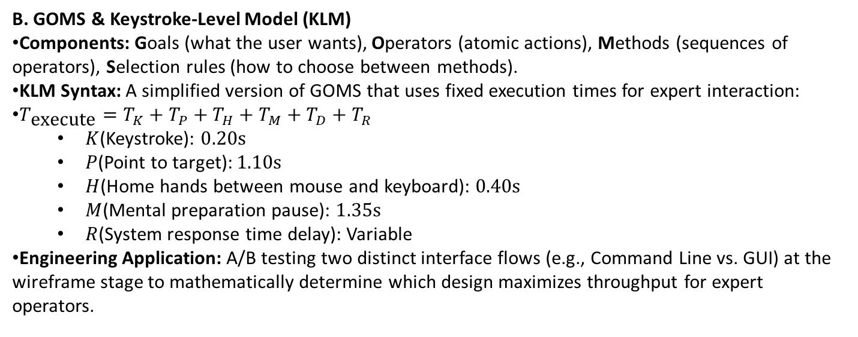
Cognitive & Human Performance Frameworks
B. GOMS & Keystroke-Level Model (KLM)
Components: Goals (what the user wants), Operators (atomic actions), Methods (sequences of operators), Selection rules (how to choose between methods).
KLM Syntax: A simplified version of GOMS that uses fixed execution times for expert interaction:
$T_{\text{execute}}=T_{K}+T_{P}+T_{H}+T_{M}+T_{D}+T_{R}$
  $K$(Keystroke): $0.20\text{s}$
  $P$(Point to target): $1.10\text{s}$
  $H$(Home hands between mouse and keyboard): $0.40\text{s}$
  $M$(Mental preparation pause): $1.35\text{s}$
  $R$(System response time delay): Variable
Engineering Application: A/B testing two distinct interface flows (e.g., Command Line vs. GUI) at the wireframe stage to mathematically determine which design maximizes throughput for expert operators.
06 / 07 Sep 2026

Slide 6
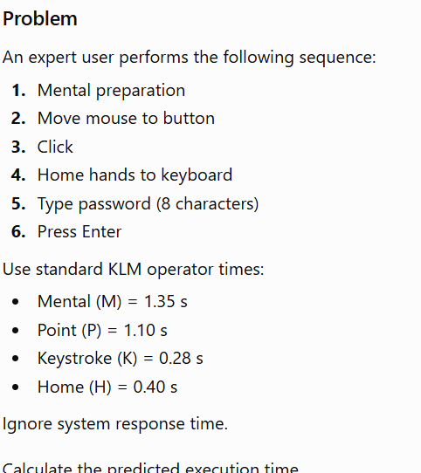
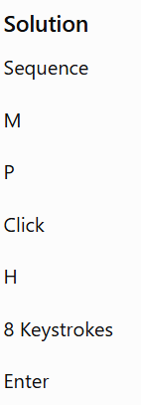
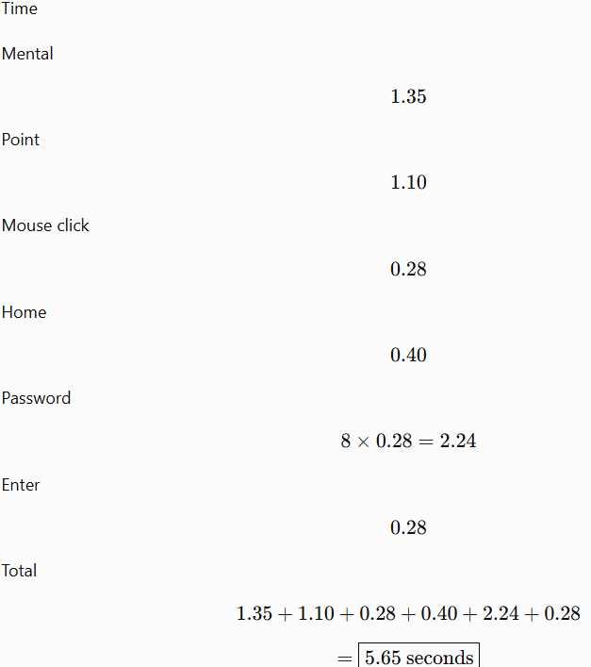
Cognitive & Human Performance Frameworks
06 / 07 Sep 2026

Slide 7
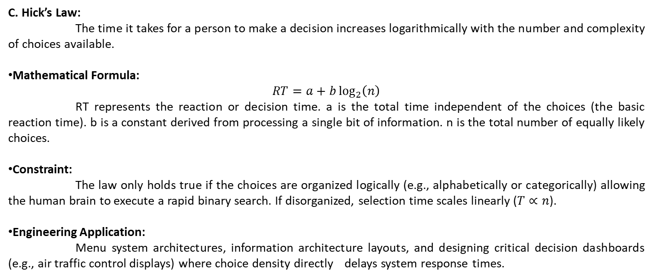
Cognitive & Human Performance Frameworks
C. Hick’s Law:
The time it takes for a person to make a decision increases logarithmically with the number and complexity of choices available.
Mathematical Formula:
$$RT=a+b\log_{2}\left(n\right)$$
RT represents the reaction or decision time. a is the total time independent of the choices (the basic reaction time). b is a constant derived from processing a single bit of information. n is the total number of equally likely choices.
Constraint:
The law only holds true if the choices are organized logically (e.g., alphabetically or categorically) allowing the human brain to execute a rapid binary search. If disorganized, selection time scales linearly ($T∝n$).
Engineering Application:
Menu system architectures, information architecture layouts, and designing critical decision dashboards (e.g., air traffic control displays) where choice density directly delays system response times.
06 / 07 Sep 2026

Slide 8
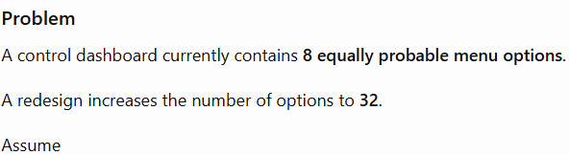
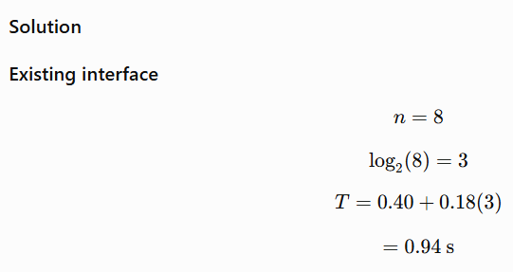
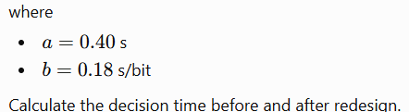
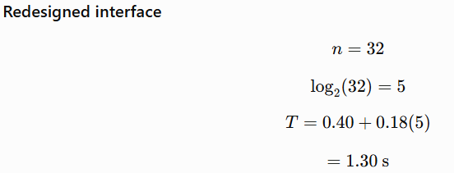

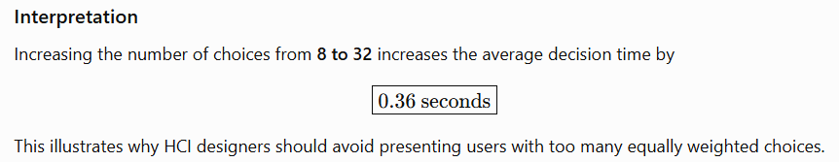
Cognitive & Human Performance Frameworks
06 / 07 Sep 2026

